Slide 1

B Trees
Prof. Zhenyu He
Harbin Institute of Technology, Shenzhen

Slide 2

OUTLINE
Introduction
Definition
Basic operations
Applications

Slide 3
INTRODUCTION
Motivation
Overview
Original Publication
B-tree …

Slide 4

MOTIVATION
○ When data is too large to fit in main memory,
then the number of disk accesses becomes
important.
○ Disk access is unbelievably expensive compared
to a typical computer instruction (mechanical
limitations).
○ One disk access is worth about 200,000
instructions.
○ The number of disk accesses will dominate the
running time.
4

Slide 5

MOTIVATION (CONT.)
○ Secondary memory (disk) is divided into equal-
sized blocks (typical sizes are 512, 2048, 4096 or
8192 bytes)
○ Basic I/O operation transfers the contents of one
disk block to/from main memory.
○ Goal is to devise a multiway search tree that will
minimize file accesses (by exploiting disk block
read).
5

Slide 6
OVERVIEW
○ Have many children,from a handful to thousands
○ The "branching factor" of a B-tree can be quite
large, although it is usually determined by
characteristics of the disk unit used.
○ B-trees are similar to red-black trees in that
every n-node B-tree has height O(lg n), although
the height of a B-tree can be considerably less
than that of a red-black tree because its
branching factor can be much larger.
6

Slide 7
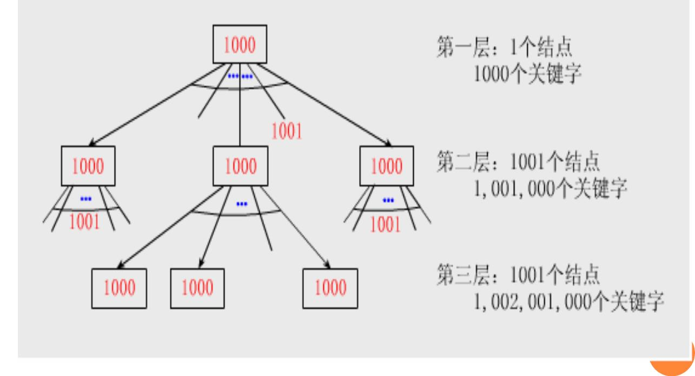
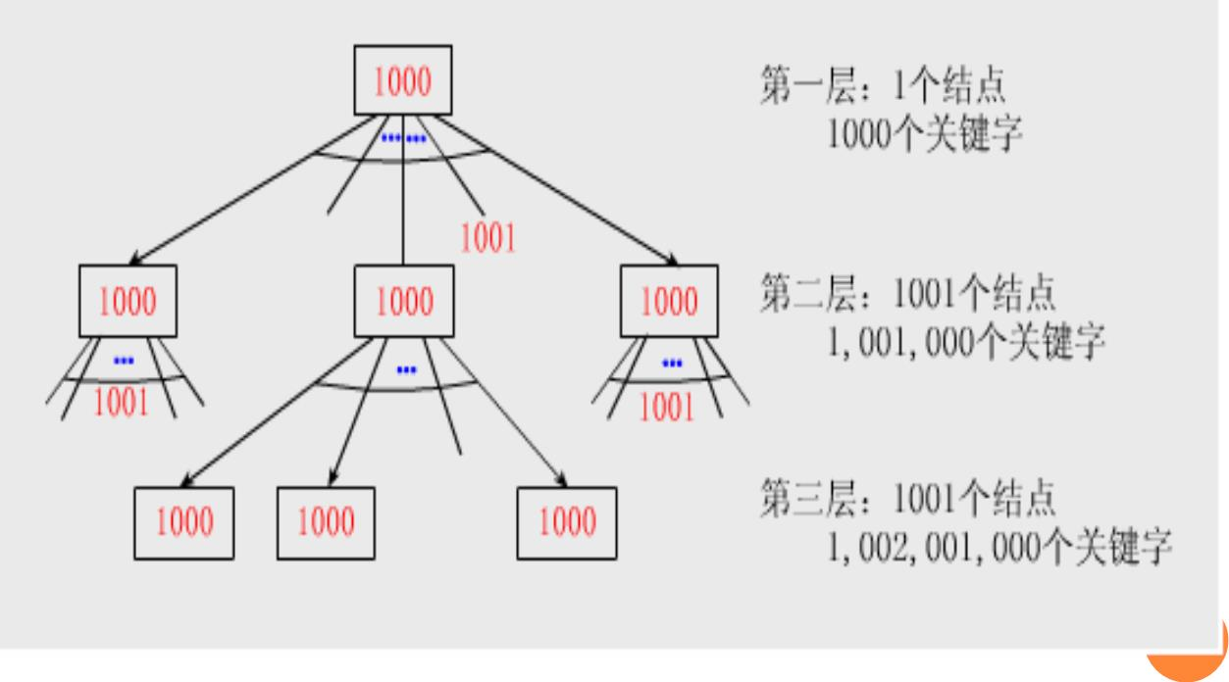
EXAMPLE

Slide 8
EXAMPLE (CONT.)
○ For a large B-tree stored on a disk, branching factors
between 50 and 2000 are often used,depending on the
size of a key relative to the size of a page. A large
branching factor dramatically reduces both the height of
the tree and the number of disk accesses required to find
any key.
○ This B-tree with a branching factor of 1001 and height 2
that can store over one billion keys; nevertheless, since
the root node can be kept permanently in main memory,
only two disk accesses at most are required to find any
key in this tree!
8

Slide 9
OVERVIEW-STRUCTURES
○ If an internal B-tree node x contains n[x] keys, then x has
n[x] + 1 children.
○ The keys in node x are used as dividing points separating
the range of keys handled by x into n[x] + 1subranges,
each handled by one child of x. When searching for a key
in a B-tree, we make an (n[x] + 1)-way decision based on
comparisons with the n[x] keys stored at node x.
○ The structure of leaf nodes differs from that of internal
nodes; we will examine these differences later
9

Slide 10
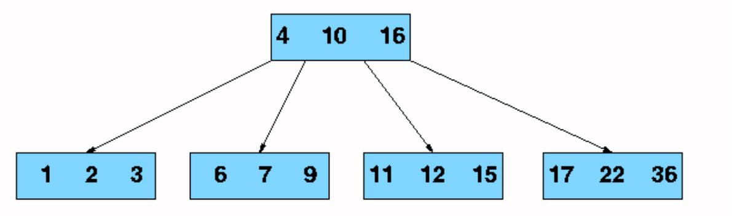
B-TREE EXAMPLE
10

Slide 11
HOW TO WORK
○ In a typical B-tree application, the amount of data
handled is so large that all the data do not fit into main
memory at once.
○ The B-tree algorithms copy selected pages from disk into
main memory as needed and write back onto disk the
pages that have changed.
○ B-tree algorithms are designed so that only a constant
number of pages are in main memory at any time;
thus,the size of main memory does not limit the size of
B-trees that can be handled.
11

Slide 12
THE ORIGINAL PUBLICATION
○ Rudolf Bayer, Edward M. McCreight
○ Organization and Maintenance of Large Ordered Indices
○ 1972
12

Slide 13
B-TREE…
○ Also known as balanced multiway tree
○ Generalization (I am a kind of ...)
balanced tree, search tree.
○ Specialization (... is a kind of me.)
2-3-4 tree, B*-tree, 2-3 t ree. .
13

Slide 14
B-TREE (CONT.)
○ The B-tree's creators, Rudolf Bayer and Ed McCreight,
have not explained what, if anything, the B stands for.
The most common belief is that B stands for balanced,
as all the leaf nodes are at the same level in the tree. B
may also stand for Bayer, or for Boeing, because they
were working for Boeing Scientific Research Labs at the
time.
14

Slide 15
OUTLINE
Introduction
Definition
Basic operations
Applications

Slide 16
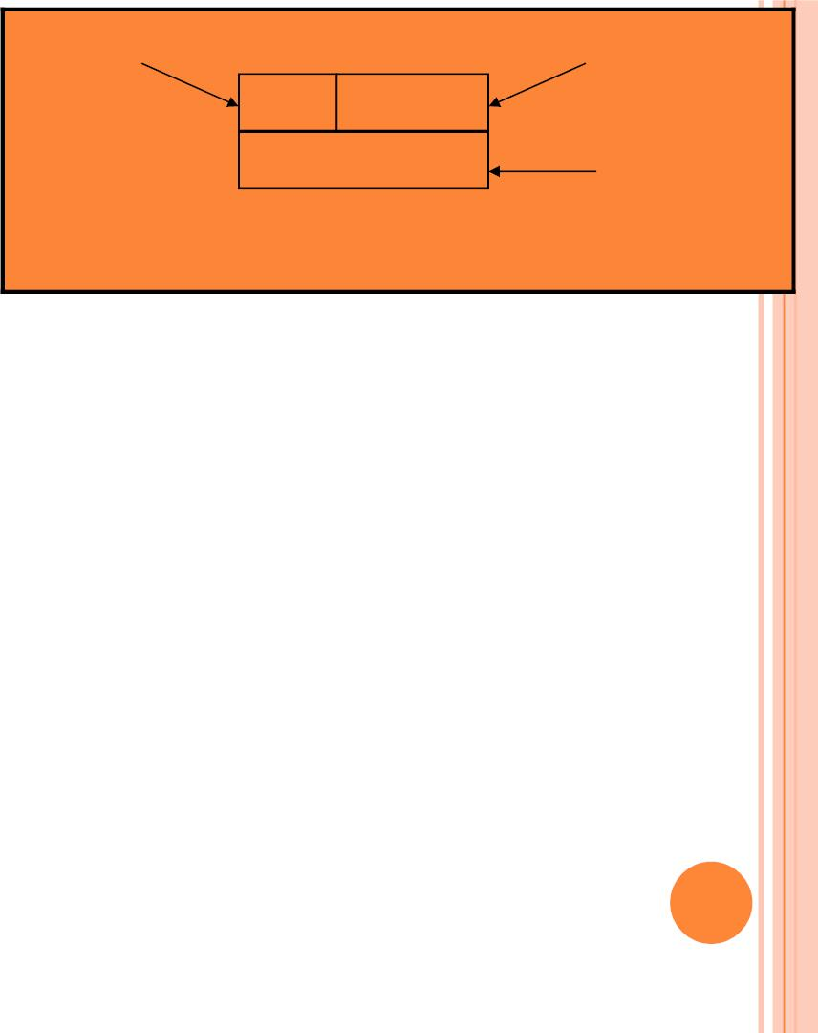
n[x]
leaf[x]
3
FALSE
Q T X
key_{i}[x]
DEFINITION
i=1..n[x]
A B-tree T is a rooted tree having the following
properties:
○ 1 Every node x has the following fields
 n[x], the number of keys currently stored in node x
 The n[x] keys themselves stored in nondecreasing order, so
that key [x] ≤ key [x] ≤ … ≤ key [x]
1
2
n[x]
 Leaf[x],a boolean value that is TRUE if x is a leaf and
FALSE if x is an internal node.

Slide 17

n[x]
leaf[x]
3
FALSE
DEFINITION (CONT.)
Q T X
key_{i}[x]
^{c}i^{[x]}
... … … …
i=1..n[x]
i=1..n[x]+1
○ 2 Each internal node x also contains n[x]+1 pointers
c [x], c [x],…,c [x] to its children. leaf nodes have
1
2
n[x]+1
no children, so their c fields are undefined
i
○ 3 The keys key_{i}[x] separate the ranges of keys stored
in each subtree:if k_{i} is any key stored in the subtree
with root c_{i}[x], then
k ≤ key [x] ≤ k ≤ key [x] ≤… ≤ key [x] ≤ k
1
1
2
2
n[x]
n[x]+1
17

Slide 18
n[x]
leaf[x]
3
FALSE
DEFINITION (CONT.)
Q T X
key_{i}[x]
^{c}i^{[x]}
... … … …
i=1..n[x]
i=1..n[x]+1
○ 4 All leaves have the same depth, which is the tree’s height h.
○ 5 There are lower and upper bounds on the number of keys a
node can contain.These bounds can be expressed in terms of a
fixed integer t≥2 called a minimum degree of the B-tree:
18

Slide 19
n[x]
leaf[x]
3
FALSE
DEFINITION (CONT.)
Q T X
key_{i}[x]
^{c}i^{[x]}
... … … …
i=1..n[x]
i=1..n[x]+1
 Every node other than the root must have at least t-1 keys. Every
internal node other than the root thus has at least t children, If
the tree is nonempty, the root must have at least one key
 Every node can contain at most 2t-1 keys, therefore, an internal
node can have at most 2t children. we say that a node is full if it
contains exactly 2t-1 keys
19

Slide 20
B-TREE HEIGHT
○ h≤log_{t} ((n+1)/2) (page 439-440)
○ The worst case height is O(log n). Since the "branchiness" of
a b-tree can be large compared to many other balanced tree
structures, the base of the logarithm tends to be large
○ Therefore, the number of nodes visited during a search tends
to be smaller than required by other tree structures. Although
this does not affect the asymptotic worst case height, b-trees
tend to have smaller heights than other trees with the same
asymptotic height.
20

Slide 21
OUTLINE
Introduction
Definition
Basic operations
Applications

Slide 22
BASIC OPERATIONS
Searching a B-tree
Create an empty B-tree
Splitting a node
Inserting a key
Deleting a key

Slide 23
SEARCH-OVERVIEW
○ The search operation on a B-tree is analogous to a
search on a binary tree.
○ Instead of choosing between a left and a right child
as in a binary tree, a B-tree search must make an
(n[x] +1)-way choice. The correct child is chosen
by performing a linear search of the values in the
node.
23

Slide 24
SEARCH-PSEUDOCODE
B-TREE-SEARCH(x,k)
1 i ← 1
2 while i ≤ n[x] and k > key_{i}[x]
3 do i ← i + 1
4 if i ≤ n[x] and k = key_{i}[x]
5 then return (x, i)
6 if leaf[x]
7 then return NIL
8 else Disk-Read(c_{i}[x])
9
return B-Tree-Search(c_{i}[x], k)
24

Slide 25
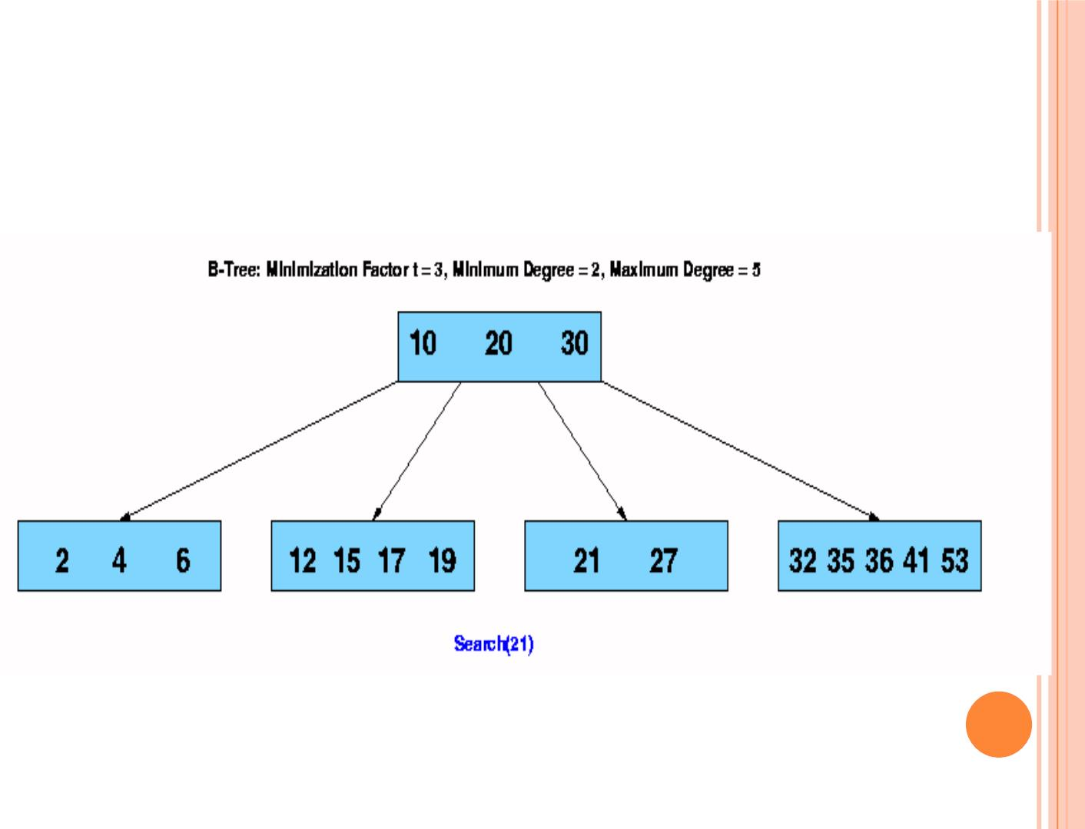
SEARCH-EXAMPLE
25

Slide 26
SEARCH-ANALYSIS
○ After finding the value greater than or equal to the
desired value, the child pointer to the immediate
left of that value is followed. If all values are less
than the desired value, the rightmost child pointer
is followed.
○ Of course, the search can be terminated as soon as
the desired node is found.
θ(log_{t} n) disk operation
○ O(tlog_{t} n) CPU time
26

Slide 27
BASIC OPERATIONS
Searching a B-tree
Create an empty B-tree
Splitting a node
Inserting a key
Deleting a key

Slide 28
CREATE-PSEUDOCODE
B-Tree-Create(T)
1 x ← Allocate-Node()
2 leaf[x] ← TRUE
3 n[x] ← 0
4 Disk-Write(x)
5 root[T] ← x
28

Slide 29

CREATE-ANALYSIS
○ The B-Tree-Create operation creates an empty b-
tree by allocating a new root node that has no
keys and is a leaf node.
○ Only the root node is permitted to have these
properties; all other nodes must meet the criteria
outlined previously.
○ O(1) disk operation
○ O(1) CPU time
29

Slide 30
BASIC OPERATIONS
Searching a B-tree
Create an empty B-tree
Splitting a node
Inserting a key
Deleting a key

Slide 31
WHY NEED SPLIT
○ When inserting a key into a B-tree ,we can’t simply
create a new leaf node and insert it, as the result tree
would fail to be a valid B-tree
○ If is node becomes "too full“, (having 2t-1 keys) it is
necessary to perform a split operation
31

Slide 32
SPLIT-OVERVIEW
○ It splites a full node y (having 2t-1 keys) around its
median key key_{t}[y] into two nodes having t-1 keys
each.The median key moves up into y’s parent to identify
the dividing point between the two new trees
32

Slide 33
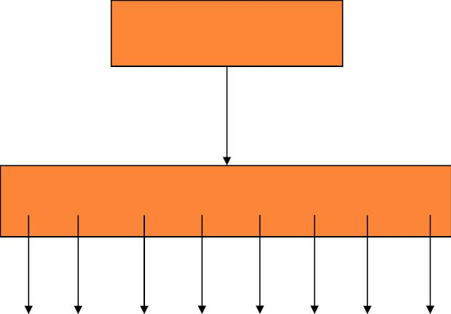
x
…N W…
y=c_{i}[x]
P Q R S T U V
T T T T T T T T
1
2
3
4
5
6
7
8
33

Slide 34
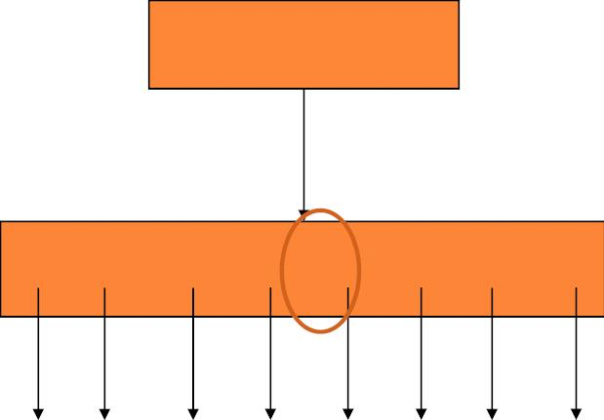
x
…N W…
y=c_{i}[x]
P Q R S T U V
T T T T T T T T
1
2
3
4
5
6
7
8
34

Slide 35
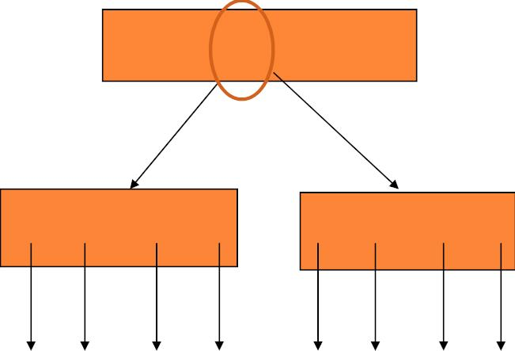
x
…N S W…
y=c_{i}[x]
z=c [x]
i+1
P Q R
T U V
T T T T
T T T T
1
2
3
4
5
6
7
8
35

Slide 36
SPLIT-PSEUDOCODE
B-Tree-Split-Child(x, i, y)
1 z← Allocate-Node()
2 leaf[z] ← leaf[y]
3 n[z] ← t - 1
4 for j ← 1 to t - 1
5 do key [z] ← key [y]
j
j+t
6 if not leaf[y]
7 then for j ← 1 to t
do c [z] ← c [y]
8
j
j+t
9 n[y] ← t - 1
36

Slide 37
SPLIT-PSEUDOCODE (CONT.)
10 for j ← n[x] + 1 downto i + 1
11 do c [x] ← c [x]
j+1
j
12 c_{i+1}[x] ← z
13 for j ← n[x] downto i
14 do key [x] ← key [x]
j+1
j
15 key [x] ← key [y]
i
t
16 n[x] ← n[x] + 1
17 Disk-Write(y)
18 Disk-Write(z)
19 Disk-Write(x)
37

Slide 38
SPLIT-ANALYSIS
○ The split operation moves the median key of node y into
its parent x where y is the ith child of x. A new node , z, is
allocated, and all keys in y right of the median key are
moved to z. The keys left of the median key remain in
the original node y.
○ The new node, z, becomes the child immediately to the
right of the median key that was moved to the parent x,
and the original node, y, becomes the child immediately
to the left of the median key that was moved into the
parent x.
38

Slide 39
SPLIT-ANALYSIS (CONT.)
○ The split operation transforms a full node with 2t - 1
keys into two nodes with t - 1 keys each. Note that one
key is moved into the parent node.
O(1) disk operations
○ θ(t) CPU times
39

Slide 40
BASIC OPERATIONS
Searching a B-tree
Create an empty B-tree
Splitting a node
Inserting a key
Deleting a key

Slide 41
INSERT-OVERVIEW
○ To perform an insertion on a B-tree, the appropriate node
for the key must be located using an algorithm similar to
B-Tree-Search.
○ Next, the key must be inserted into the node.
 If the node is not full prior to the insertion, no special action is
required;
 However, if the node is full, the node must be split to make room
for the new key.
○ Since splitting the node results in moving one key to the
parent node, the parent node must not be full or another
split operation is required. This process may repeat all
the way up to the root and may require splitting the root
node.
41

Slide 42
INSERT-OVERVIEW (CONT.)
○ This approach requires two passes. The first pass locates
the node where the key should be inserted; the second
pass performs any required splits on the ancestor nodes.
○ We don’t wait to find out whether we will need to split a
full node.Instead,as we travel down the tree searching for
the new key belongs ,we split each full node we come to
along the way.Thus whenever we want to split a full
node y ,we are assumed that its parents is not full.
42

Slide 43
INSERT-PSEUDOCODE (1)
B-Tree-Insert(T, k)
1 r ← root[T]
2 if n[r] = 2t - 1
3 then s ← Allocate-Node()
4
5
6
7
8
9
root[T] ← s
leaf[s] ← FALSE
n[s] ← 0
c₁ ← r
B-Tree-Split-Child(s, 1, r)
B-Tree-Insert-Nonfull(s, k)
10 else B-Tree-Insert-Nonfull(r, k)
43

Slide 44
INSERT-PSEUDOCODE (2)
B-Tree-Insert-Nonfull(x, k)
1 i ← n[x]
2 if leaf[x]
3 then while i ≥1 and k < key_{i}[x]
4
5
6
7
8
do key [x] i ← key [x]
i ← i - 1
key_{i+1}[x] ← k
n[x] ← n[x] + 1
Disk-Write(x)
i+1
i
44

Slide 45
INSERT-PSEUDOCODE (2 CONT.)
9 else while i ≥1 and k < key_{i}[x]
10
11
12
13
14
15
16
17
do i ← i - 1
i ← i + 1
Disk-Read(c_{i}[x])
if n[c_{i}[x]] = 2t - 1
then B-Tree-Split-Child(x, i, c_{i}[x])
if k > key_{i}[x]
then i ← i + 1
B-Tree-Insert-Nonfull(c_{i}[x], k)
45

Slide 46

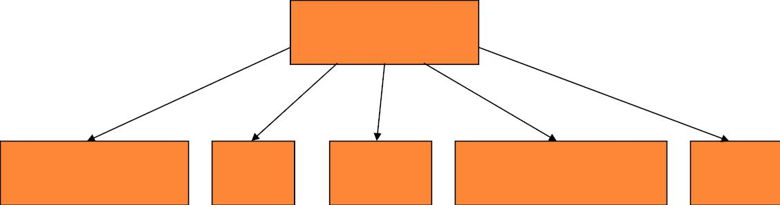
Insert B
B
G M P X
A C D E J K N O R S T U V Y Z
46

Slide 47
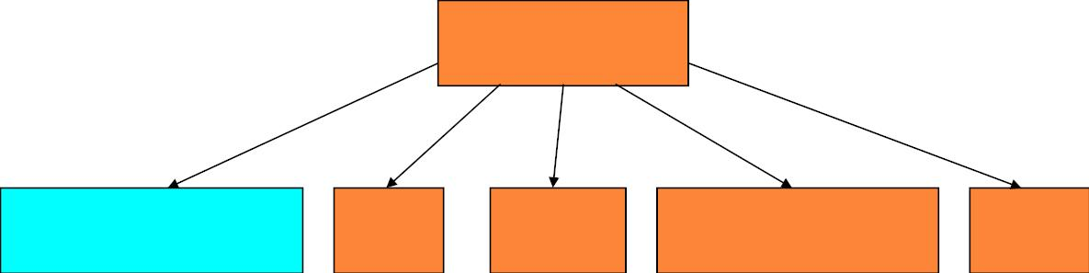
Insert B
G M P X
A B C D E J K N O R S T U V Y Z
47

Slide 48

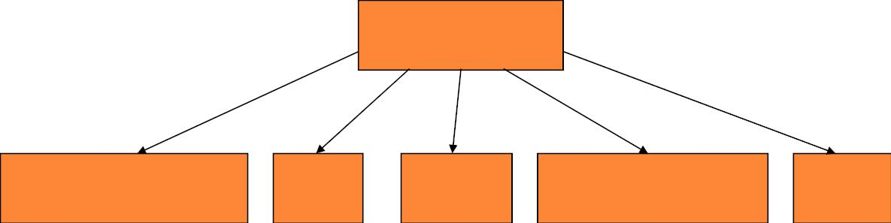
Insert Q
Q
G M P X
A B C D E J K N O R S T U V Y Z
48

Slide 49
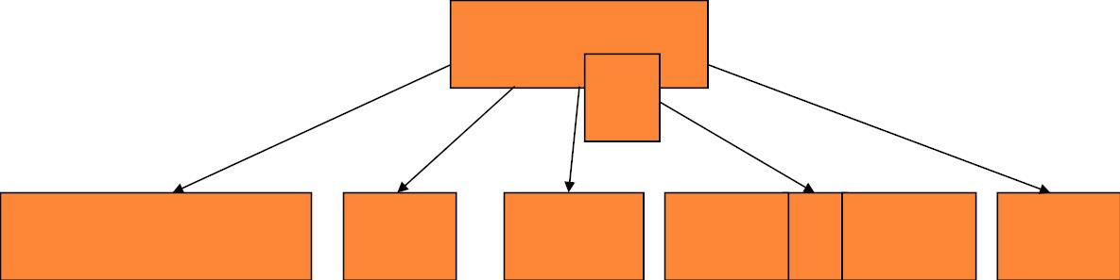
Insert Q
G M P X
Q
A B C D E J K N O R S T U V Y Z
49

Slide 50
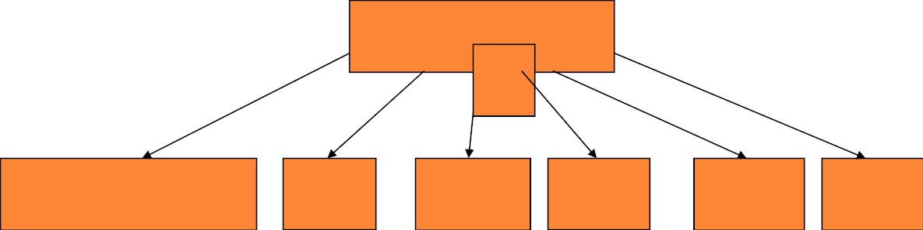
Insert Q
G M P T X
Q
A B C D E J K N O R S U V Y Z
50

Slide 51
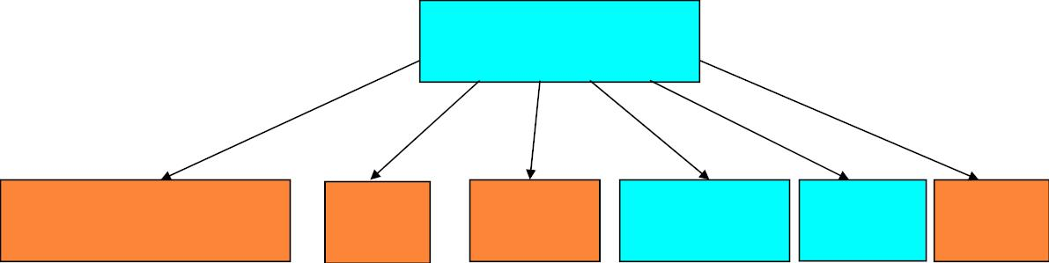
Insert Q
G M P T X
A B C D E J K N O Q R S U V Y Z
51

Slide 52
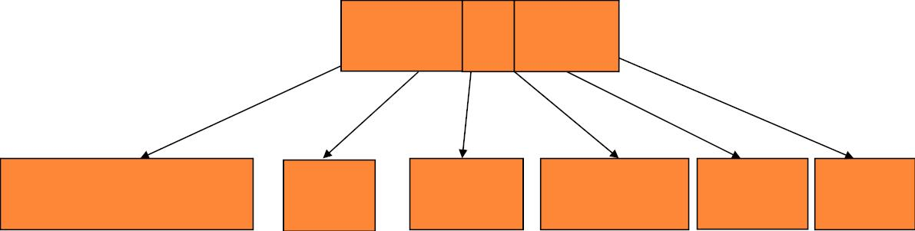
Insert L
L
G M P T X
A B C D E J K N O Q R S U V Y Z
52

Slide 53
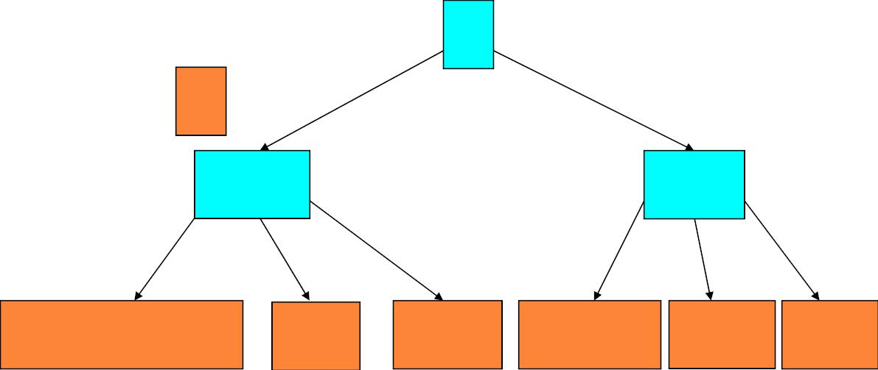
Insert L
P
L
G M
T X
A B C D E J K N O Q R S U V Y Z
53

Slide 54
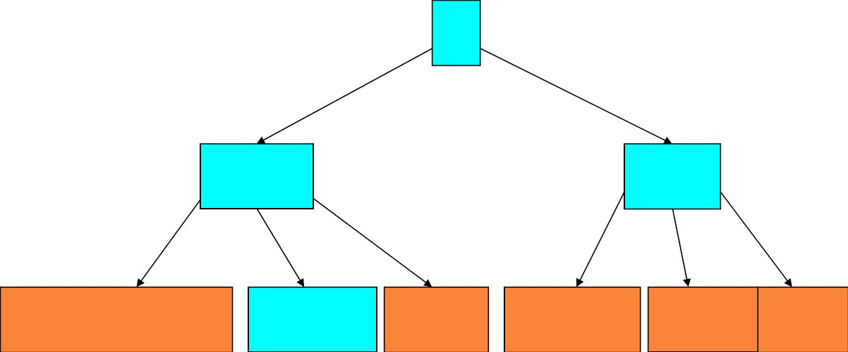
Insert L
P
G M
T X
A B C D E J K L N O Q R S U V Y Z
54

Slide 55
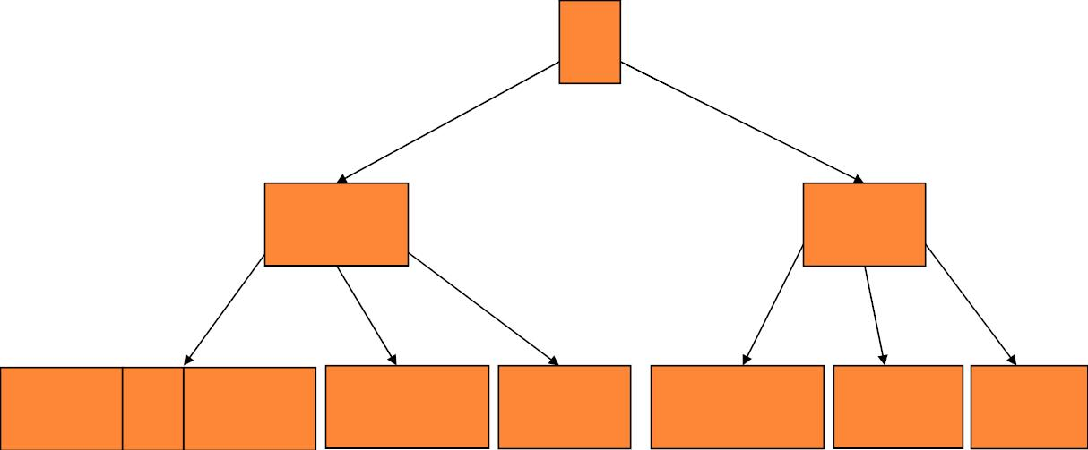
Insert F
F
P
G M
T X
A B C D E J K L N O Q R S U V Y Z
55

Slide 56
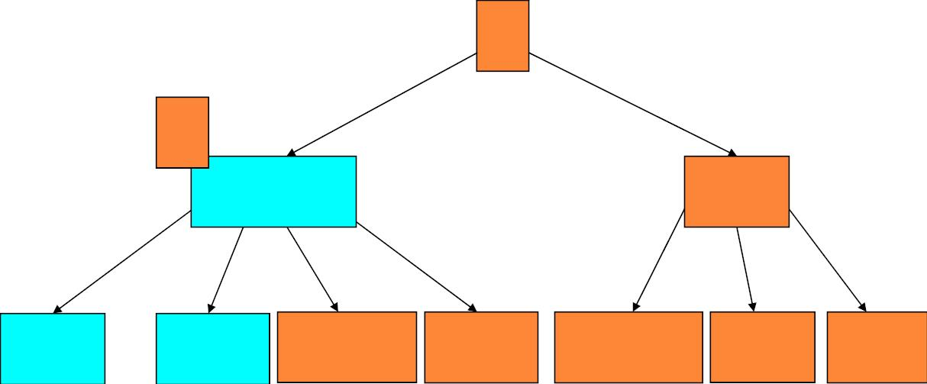
Insert F
P
F
C G M
T X
A B D E J K L N O Q R S U V Y Z
56

Slide 57
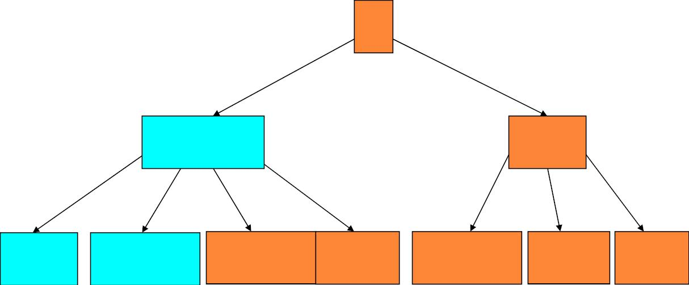
Insert F
P
C G M
T X
A B D E F J K L N O Q R S U V Y Z
57

Slide 58
INSERT-ANALYSIS
○ Since each access to a node may correspond to a costly
disk access, it is desirable to avoid the second pass by
ensuring that the parent node is never full. To accomplish
this, the presented algorithm splits any full nodes
encountered while descending the tree.
○ Although this approach may result in unecessary split
operations, it guarantees that the parent never needs to be
split and eliminates the need for a second pass up the tree.
Since a split runs in linear time, it has little effect on the
O(t log_{t} n) running time of B-Tree-Insert.
58

Slide 59
BASIC OPERATIONS
Searching a B-tree
Create an empty B-tree
Splitting a node
Inserting a key
Deleting a key

Slide 60
DELETE-OVERVIEW
○ There are two popular strategies for deletion
from a B-Tree.
 locate and delete the item, then restructure the tree to
regain its invariants
 do a single pass down the tree, but before entering
(visiting) a node, restructure the tree so that once the
key to be deleted is encountered, it can be deleted
without triggering the need for any further
restructuring
60

Slide 61

DELETE-CASES
○ 1. If the key k is in node x and x is a leaf, delete
the key k from x. example
○ 2. If the key k is in node x and x is an internal
node, do the following.
 a. If the child y that precedes k in node x has at least t
keys, then find the predecessor k′ of k in the subtree
rooted at y. Recursively delete k′, and replacek by k′ in
x. (Finding k′ and deleting it can be performed in a
single downwardpass.) example
61

Slide 62
DELETE-CASES (CONT.)
 b. Symmetrically, if the child z that follows k in node
x has at least t keys, then find the successor k′ of k in
the subtree rooted at z. Recursively delete k, and
replace k by k′ in x. (Finding k′ and deleting it can be
performed in a single downward pass.)
 c. Otherwise, if both y and z have only t - 1 keys,
merge k and all of z into y, so that x loses both k and
the pointer to z, and y now contains 2t - 1 keys.
Then,free z and recursively delete k from y.example
62

Slide 63
DELETE-CASES (CONT.)
○ 3. If the key k is not present in internal node x, determine
the root ci[x] of the appropriate subtree that must contain
k, if k is in the tree at all. If ci[x] has only t - 1 keys,
execute step 3a or 3b as necessary to guarantee that we
descend to a node containing at least t keys. Then, finish
by recursing on the appropriate child of x.
 a. If ci[x] has only t - 1 keys but has an immediate sibling with at
least t keys, give ci[x] an extra key by moving a key from x down
into ci[x], moving a key from ci[x]'s immediate left or right
sibling up into x, and moving the appropriate child pointer from
the sibling into ci[x]. example
63

Slide 64
DELETE-CASES (CONT.)
 b. If ci[x] and both of ci[x]'s immediate siblings have t - 1
keys, merge ci[x] with one sibling, which involves moving a
key from x down into the new merged node to become the
median key for that node. example
64

Slide 65
VARIETIES
○ 2-3-4 tree is a B-tree of order 4
○ 2-3 tree is a B-tree that can contain only 2-nodes (a node
with 1 field and 2 children) and 3-nodes (a node with 2
fields and 3 children)
○ B+ tree (also known as a Quarternary Tree) is a variety
of B-tree, in contrast to a B-tree, all records are stored at
the lowest level of the tree; only keys are stored in
interior blocks.
○ B*-tree is a tree data structure, a variety of B-tree used
in the HFS and Reiser4 file systems, which requires
nonroot nodes to be at least 2/3 full instead of 1/2
79

Slide 66
OUTLINE
Introduction
Definition
Basic operations
Applications

Slide 67
APPLICATIONS
○ As databases cannot typically be maintained
entirely in memory, b-trees are often used to
index the data and to provide fast access. For
example, searching an unindexed and unsorted
database containing n key values will have a
worst case running time of O(n)
○ Search Engine Index
○ ．．．．
81

Slide 68

RUDOLF BAYER
○ Professor (emeritus) of Informatics
at the Technical University of
Munich since 1972
○ Famous for inventing two data
sorting structures: the B-tree with
Edward M. McCreight, and later
the UB-tree with Volker Markl
○ a recipient of
2001 ACM SIGMOD Edgar F.
Codd Innovations Award

Slide 69

EDWARD M. MCCREIGHT
○ Attended the College of
Wooster ('66) and
Carnegie-Mellon
University
○ Have worked at Boeing
Aircraft and Xerox PARC
○ Guest professor at the
University of Washington,
Stanford University, the
Technical University of
Munich, and the Swiss
Federal Institute of
Technology in Zürich

